Slide 1
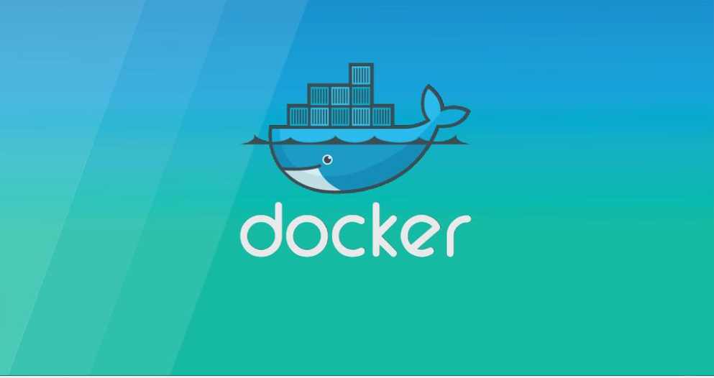

Slide 2
What is docker
Docker is an OS virtualized software platform that allows IT organizations to quickly create, deploy, and run applications in Docker containers, which have all the dependencies within them. The container itself is a very lightweight package with all the instructions and dependencies—such as frameworks, libraries, and bins—within it.

Slide 3
Docker vs Virtual Machines
The virtual environment has a hypervisor layer, whereas Docker has a Docker engine layer.
There are additional layers of libraries within the virtual machine, each of which compounds and creates very significant differences between a Docker environment and a virtual machine environment.
The boot-up time for a virtual machine is fairly slow in comparison to the boot-up time for a Docker environment, in which boot-up is almost instantaneous.

Slide 4
Advantages of Docker
The configuration itself can be scripted through a language called YAML, (yet another markup language) that allows you to describe the Docker environment you want to create. This, in turn, allows you to scale your environment quickly. But probably the most critical advantage these days is security.
Next in the getting started with docker tutorial we focus on the advantages of Docker. As noted previously, you can do rapid deployment using Docker. The environment itself is highly portable and was designed with efficiencies that allow you to run multiple Docker containers in a single environment, unlike traditional virtual machine environments.

Slide 5
How Does Docker Work?
Docker works via a Docker engine that is composed of two key elements: a server and a client; and the communication between the two is via REST API. The server communicates the instructions to the client. On older Windows and Mac systems, you can take advantage of the Docker toolbox, which allows you to control the Docker engine using Compose and Kitematic.

Slide 6
Components of Docker
some components that we will discuss in this getting started with docker tutorial:
Docker client and server
Docker image
Docker container

Slide 7
Docker Client and Server
This is a command-line-instructed solution in which you would use the terminal on your Mac or Linux system to issue commands from the Docker client to the Docker daemon.
The communication between the Docker client and the Docker host is via a REST API.
The Docker daemon itself is actually a server that interacts with the operating system and performs services
As you’d imagine, the Docker daemon constantly listens across the REST API to see if it needs to perform any specific requests.
That template is written in a language called YAML, which stands for Yet Another Markup Language.

Slide 8
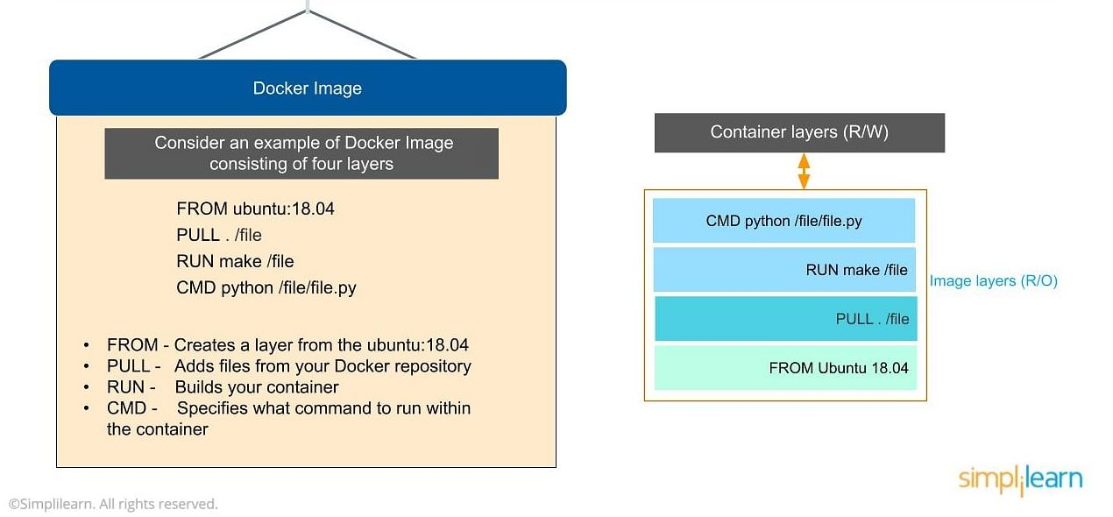
Docker Image
The Docker image is built within the YAML(yet another markup language) file and then hosted as a file in the Docker registry. The image has several key layers, and each layer depends on the layer below it. From,Pull, Run and CMD
You start with your base layer, which will typically have your base image and your base operating system, and then you will have a layer of dependencies above that.
Here we have four layers of instructions: From, Pull, Run and CMD. What does it look like? The From command creates a layer based on Ubuntu, and then we add files from the Docker repository to the base command of that base layer.

Slide 9
Docker Container
It’s really lightweight due to the built-in structural redundancy. The container is also inherently portable. Another benefit is that it runs completely in isolation. Even if you are running a container,
The memory for a Docker environment can be shared across multiple containers, which is really useful, especially when you have a virtual machine that has a defined amount of memory for each environment

Slide 10



